Slide 1
IMMANUEL KANT’S THEORETICAL MORAL ARGUMENT FOR THE EXISTENCE OF GOD
(AS RECONSTRUCTED BY ROBERT MERRIHEW ADAMS)

Slide 2
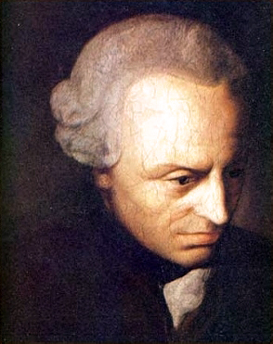
IMMANUEL KANT (1724-1804)

Slide 3
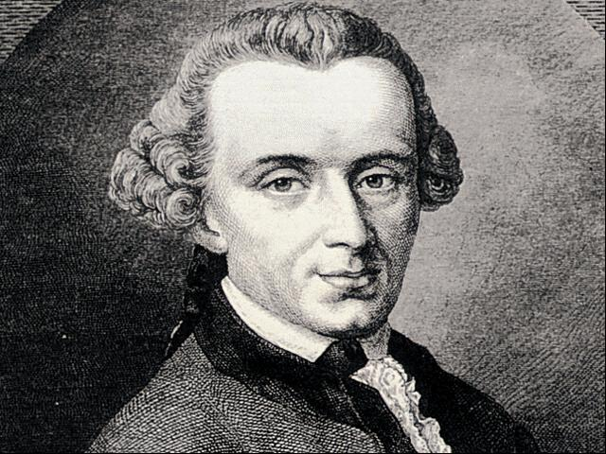

Slide 4
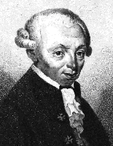

Slide 5
KANT’S THEORETICAL MORAL ARGUMENT FOR THE EXISTENCE OF GOD
We ought (morally) to promote the realization of the highest good.
(B) What we ought to do must be possible for us to do.

Slide 6
(C) It is not possible for us to promote the realization of the highest good unless there exists a God who makes the realization possible.
 (D) There exists such a God.

Slide 7
OBJECTIONS (OFFERED BY ADAMS)
The ethical correctness of Kant’s conception of the highest good is ethically correct.
Perhaps there is some non-theistic basis for the perfect proportionment of happiness to virtue.
EXPLANATION: These are both objections to premise (C ).
(Homework: Is the argument deductively valid?)

Slide 8
A STRONG OBJECTION TO PREMISE (A) (ALSO OFFERED BY ADAMS)
A STRONG OBJECTION TO PREMISE (A) (ALSO OFFERED
IN ANY REASONABLE MORALITY WE WILL BE OBLIGATED TO PROMOTE ONLY THE BEST ATTAINABLE APPROXIMATION OF THE HIGHEST GOOD.

Slide 9
(TENTATIVE) EVALUATION OF THE ARGUMENT
ADAMS’ OBJECTIONS TO THIS RECONSTRUCTION OF KANT’S ARGUMENT SEEM TO BE WELL-TAKEN. WE MAY WELL AGREE WITH HIM THAT “KANT’S THEORETICAL MORAL ARGUMENT FOR THEISM … [IS]… NOT … VERY PROMISING…”.

Slide 10
HOMEWORK
(1) EVALUATE ADAMS’ RECONSTRUCTION OF KANT’S PRACTICAL ARGUMENT FOR THEISTIC BELIEF (p. 20).
(2) FORMULATE FULLY AND EVALUATE ADAMS’ MORAL ARGUMENT FOR PROPOSITION (K) (p. 25).

Slide 11
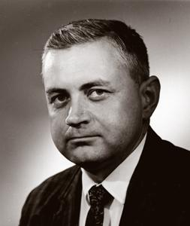
RELIGION AND THE QUEERNESS OF MORALITY
GEORGE I. MAVRODES
PROFESSOR EMERITUS, UNIVERSITY OF MICHIGAN

Slide 12
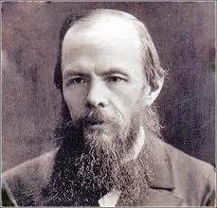
FYODOR DOSTOEVSKY (1821-1881)

Slide 13
DOSTOEVSKY’S PRINCIPLE
“IF THERE IS NO GOD, THEN EVERYTHING IS PERMITTED.”
THE BROTHERS KARAMAZOV

Slide 14
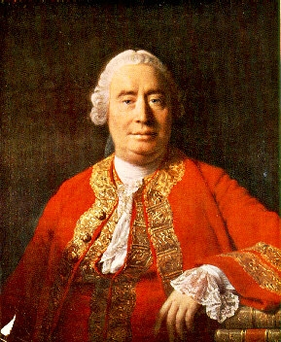
DAVID HUME (1711-1776)

Slide 15
HUME’S PRINCIPLE ABOUT “OUGHT” AND “IS”
(HP) IT IS IMPOSSIBLE TO VALIDLY DEDUCE AN “OUGHT -STATEMENT” FROM “IS- STATEMENTS.”
ANOTHER VERSION:
(HP*) NO ARGUMENT WITH PURELY FACTUAL-STATEMENTS AS PREMISES AND A VALUE- STATEMENT AS CONCLUSION CAN BE DEDUCTIVELY VALID

Slide 16
MAVRODES ON HUME’S PRINCIPLE
“If … it is taken to mean that one can divide the domain of statements into two classes, the moral and the non-moral, and that none of the latter entail any of the former, then it is false.” (p. 31)
He does not here offer any argument for his claim about Hume’s Principle.

Slide 17
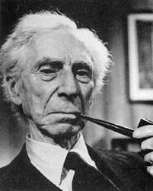
BERTRAND RUSSELL (1872-1970)

Slide 18
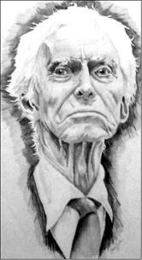
RUSSELL (EARLY 1960’S (?))

Slide 19
MAVRODES ON THREE FEATURES OF THE RUSSELLIAN WORLD
Minds and consciousness are the products of non-mental causes.
Human life is bounded by physical death.
The Human Race is doomed to extinction.

Slide 20
MAVRODES’ THREE COMMENTS ABOUT MORAL OBLIGATION
Morality includes judgments of the form “N ought to do (or avoid doing) _______.”
There is a distinction between prima facie obligations and all-things-considered obligations, but he will focus on the latter.

Slide 21
THIRD COMMENT
(3) A persons’ being unwilling to fulfill an obligation is irrelevant to his (or her) having the obligation and to the adverse judgment in case the obligation is not fulfilled.

Slide 22
OBLIGATIONS IN A RUSSELLIAN WORLD
In some cases, there is a net loss to ourselves if we fulfill an obligation. This is a contingent truth.
The world might have been such that we would have obtained a net benefit from the performance of such duties.

Slide 23
SUCH A WORLD WOULD BE VERY STRANGE UNLESS…
(1) Judgments of moral obligation can be analyzed in terms of the speaker – e.g. as expressing his (her) feelings or his (her) only attempting to incite a similar attitude in someone else. (Metaethics again!) - or
(2) Judgments of moral obligation can be analyzed in terms of the attitudes of the person said (by the speaker) to have the obligation. (Ditto)

Slide 24
OBJECTION: THERE IS A NET BENEFIT TO ME TO BE MORAL (EVEN IN A RUSSELLIAN WORLD)
It is in everyone’s best interest (including mine) for everyone (including me) to be moral.
Therefore:
It is in my best interest for everyone (including me) to be moral.
Therefore:

Slide 25
(ARGUMENT CONTINUED)
Therefore:
( C) It is in my best interest for me to be moral.
If this argument is cogent, it shows that moral obligations would not be so strange in a Russellian World.

Slide 26
MAVRODES’ CRITIQUE OF THE ARGUMENT
FIRST OBJECTION:
(1) The (sub-) argument from (B) to (C) is not deductively valid .

Slide 27
MAVRODES’ CRITIQUE OF THE ARGUMENT (CONT’)
SECOND OBJECTION:
Premise (A ) is equivocal:
(i) On one interpretation of (A), (B) does not follow from (A).
(ii) On the other interpretation of (A), (B) does follow. But on this understanding, (A) is very implausible.

Slide 28
HOMEWORK
VOCABULARY FOR MAVRODES’ “RELIGION AND THE
QUEERNESS OF MORALITY”:
1. FIND OUT THE MEANINGS OF THE FOLLOWING PHILOSOPHICAL TERMS
Prima facie obligations
“All-things-considered” obligations
Distributive interpretation of a universal statement
Collective interpretation of a universal statement
2. LOOK UP THE DEFINITION OF: “FALLACY OF AMBIGUITY (OR EQUIVOCATION)”

Slide 29
THE FALLACY OF EQUIVOCATION
An argument commits the Fallacy of Equivocation =_{df} The argument contains a word, phrase or sentence that is ambiguous (equivocal) and the argument is not deductively valid if we take one of the readings throughout and not cogent with if we use a different reading.

